Slide 1


Generative Diffusion Models for Audio Inpainting
Facoltà di Ingegneria dell’informazione, informatica e statistica
Engineering in Computer Science
Andrea Rodriguez
1834937
Advisor
Prof. Danilo Comminiello
Notes:
Good morning, today I’m presenting my thesis work. I experimented with generative diffusion models applied to audio inpainting. The focus of my work was in adapting the numerous techniques available for image inpainting to the audio domain, which is still mostly unexplored today.

Slide 2
Generative Diffusion Models for Audio Inpainting
1
Background: Task, Diffusion models and Spectrograms
2
State-of-the-Art: AudioLDM
3
Selected technique: Tango + RePaint
4
Additional use case: Denoising in communication scenarios
Notes:
In this presentation I’ll first talk about the basic elements we need to know to understand the context. Then I’ll present the state-of-the-art model for audio generation. I’ll continue showing the technique we used for inpainting and I’ll show the results. Finally I will discuss an additional use case regarding communication scenarios.

Slide 3
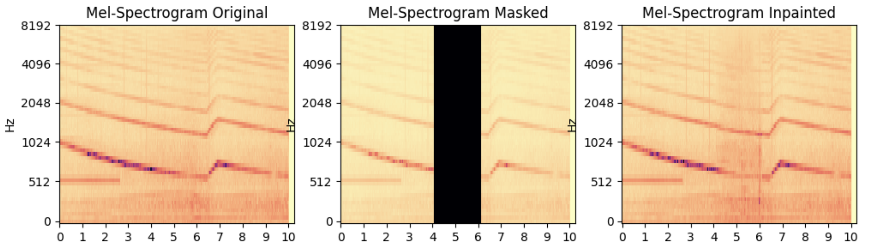
Audio generation and Audio inpainting
Produce audio from textual descriptions that is indistinguishable from human-created or real-world audio
Audio Generation
Generate audio samples with similar characteristics to the training data, also showcasing innovative attributes
Audio Inpainting
Reconstruct missing or corrupted portions of audio signals and restore the original audio content
Notes:
Audio generation is the process of creating new and realistic audio content. In this work we mainly discuss Text-To-Audio generation, which employs a textual description to generate the audio clips. Audio inpainting, instead, involves the reconstruction of missing portions of audio signals, aiming to restore the original audio content. The main goal is ensuring coherence and continuity in the inpainted audio, blending the generated portion into the available one.

Slide 4
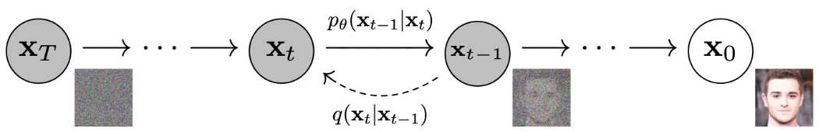
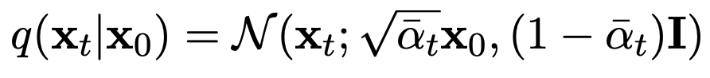
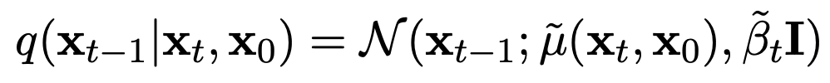
Diffusion models
Iteratively transform an initial noise distribution into a target distribution
Generate high-quality samples and perform denoising and inpainting
Main concepts
Forward process: using a variance schedule, small amounts of Gaussian noise are added to the sample in T steps
Reverse process: the noise added at each step of the forward process is predicted and removed from initial noise
Notes:
Let’s start with a background on diffusion models. They are a class of generative models which iteratively transform an initial noise distribution into a target distribution, to generate new samples and perform a range of tasks such as denoising and inpainting. Diffusion models work in two phases. In the forward process small amounts of Gaussian noise are added to the input sample through a series of steps. The model, which is a UNet, learns this noise which is then removed in the reverse process to generate samples from initial noise.

Slide 5
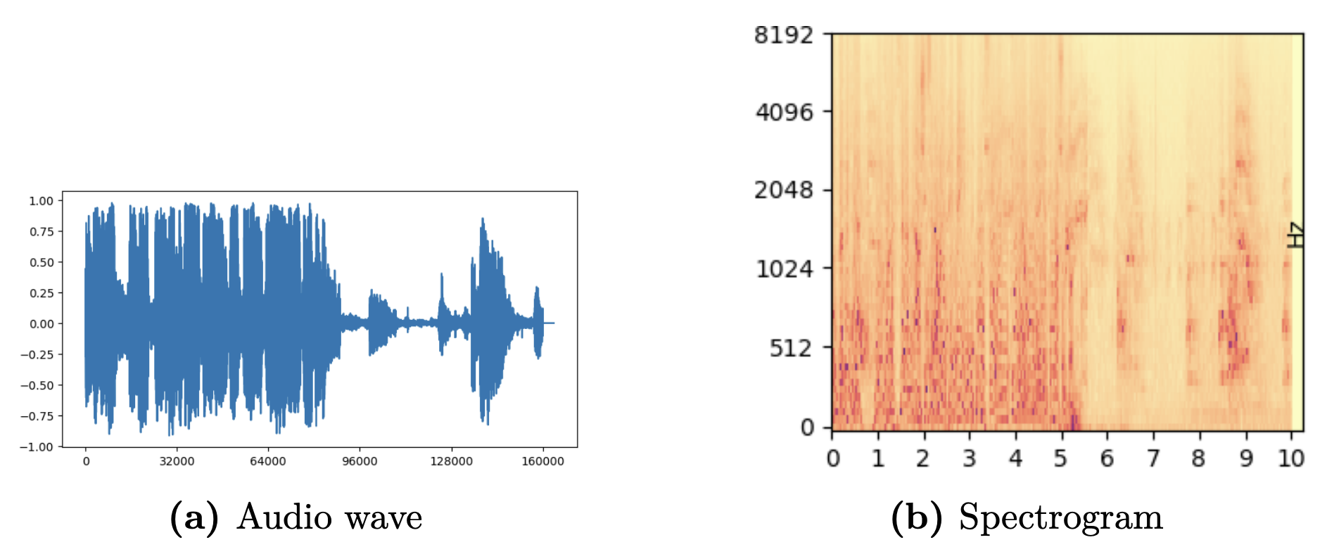
Spectrograms
A spectrogram is a visual representation that displays the frequency content of an audio signal over time
Vector 1 x 160000 (10 seconds)
Matrix 1024 x 64 (10 seconds)
Sparsity → Computationally demanding and Risk of overfitting
Dense representation → Capture long term dependencies and Efficient training
Notes:
When working with audio in machine learning, the choice of representation heavily impacts the efficiency and effectiveness of the models. Waveforms suffer from inherent sparsity, so models have to process and analyze a considerable amount of consecutive samples which leads them to lose long-term dependencies and increases the execution time. To overcome this problem we used spectrograms, which are a compressed representation of the frequency content of an audio over time and therefore allow the models to extract meaningful patterns.

Slide 6
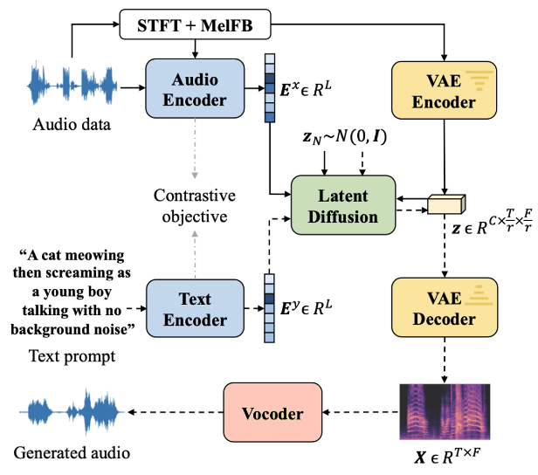
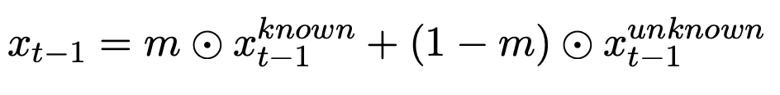
State-of-the-Art: AudioLDM
CLAP (Contrastive Language-Audio Pretraining): encode audio descriptions and audio clips into a shared audio-text embedding space
VAE (Variational Autoencoder): compress the spectrogram into a compact latent space
Latent Diffusion: the conditioning information is integrated into the feature extraction process
Vocoder: synthesizes the audio waveform from the generated spectrogram
Inpainting:
x^{known} is sampled from the known part
x^{unknown} is sampled from the model
The two components are combined according to the mask m
Notes:
AudioLDM is the first baseline we considered. It is a text-to-audio system based on a diffusion model, whose main characteristic is the use of a Contrastive Language-Audio Pretraining which can map both textual descriptions and audio clips in a shared latent space. It also uses a Variational Autoencoder to convert the audio input into a spectrogram and then map it to a latent space in which the diffusion model is trained. Inpainting has been implemented using a standard modification in the inference process, which combines at each step the known part of the audio clip with the generated one according to the mask.

Slide 7
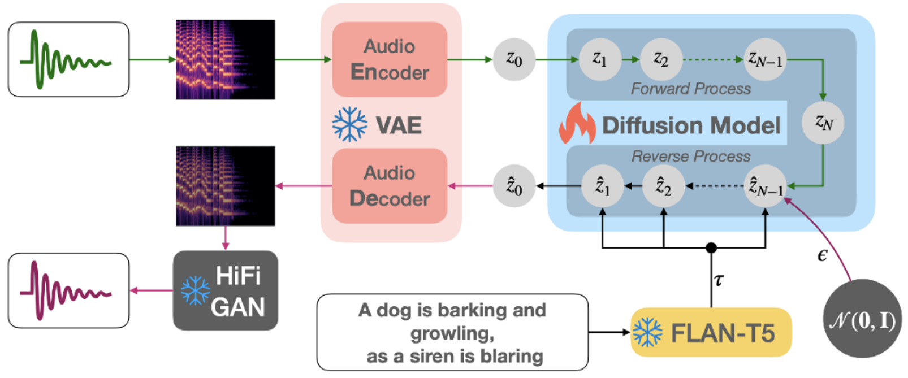
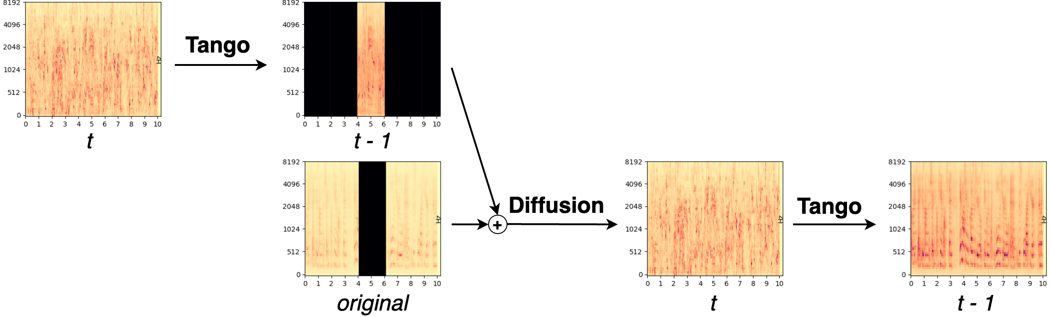
Tango + RePaint
FLAN-T5:
Instruction-tuned LLM architecture used as text encoder
Trained on a large-scale chain-of-thought and instruction-based dataset
RePaint: sample the unmasked regions using the available information as conditioning during the diffusion process
Notes:
The first approach we tried is a combination of the generative diffusion model Tango and the inference technique RePaint. Tango is another Text-to-Audio model similar to AudioLDM. Its main novelty lies in the adoption of FLAN-T5, which is an instruction-tuned Large Language Model used as text encoder for the audio captions. To perform inpainting we used RePaint, a technique developed for images which we adapted to the audio domain. In this approach, the generation process of the unknown regions is conditioned using the available part of the audio. Moreover, the resampling approach is introduced: the output of a reverse step is diffused back to the previous one and the sampling is performed again. Despite adding noise in the diffusion step, some information is still retained and used to generate a more harmonized output. This technique is particularly effective when the input audio is clean and doesn’t need denoising.

Slide 8

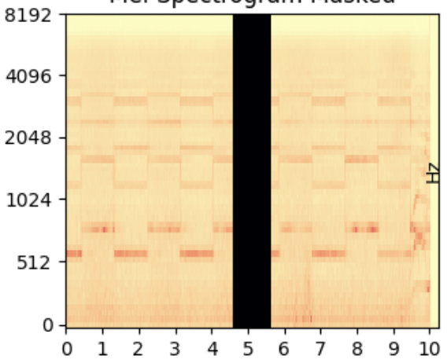
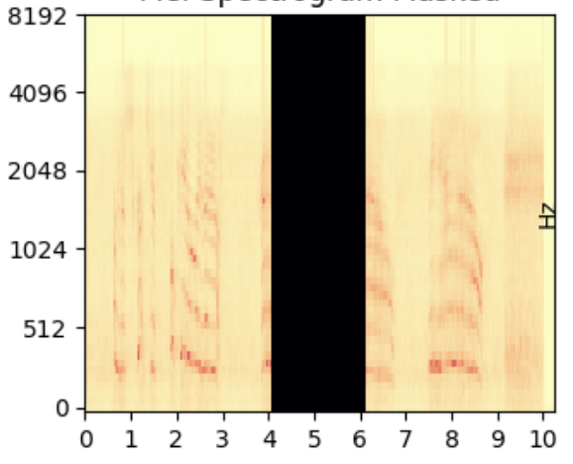
Audio samples and Inference details
Tests were performed using 24 audio clips from the AudioCaps dataset
“Female and male are having conversation”
“An emergency vehicles’ siren with a brief male yell”
“Duck quacking repeatedly”
1 second gap
2 seconds gap
Listen to the audio clips at: https://www.andrearodriguez.it/inpainting
Notes:
We tested this technique using 24 audio clips from the AudioCaps dataset. These clips are 10 seconds segments from youtube videos with a human written caption. The chosen audio samples include speech clips [esempio], audios with an evident pattern in the spectrogram [esempio] and a mixture of different sounds [esempio]. We tested the inpainting capabilities adding both one and two seconds gaps in the middle of each audio clip.

Slide 9
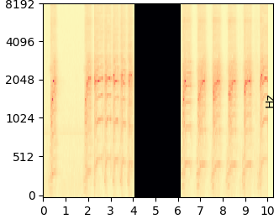
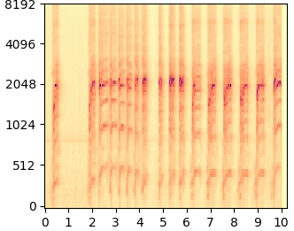
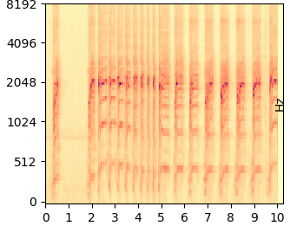
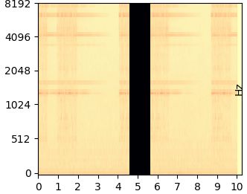
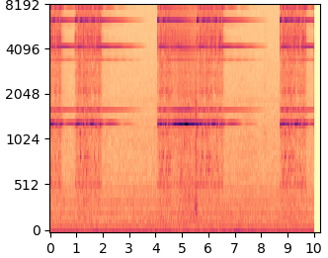
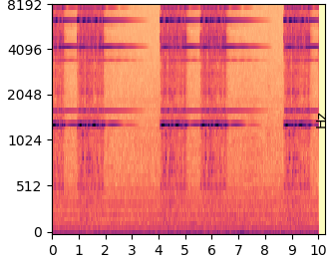
Results
“Duck quacking repeatedly”
Masked
Inpainted using RePaint
Original
“A telephone ringing”
Notes:
Let’s listen to some results to give you an idea of the capabilities of this technique. The first clip contains a duck quacking, here is the masked sample [masked] and the inpainted one [inpainted]. The second clip is instead of a telephone ringing [masked] [inpainted]. In this second clip you can see from the spectrograms that the model didn’t reconstruct exactly the original audio. However, in certain use cases, the reconstruction of a plausible waveform can be considered a successfully inpainted clip.

Slide 10
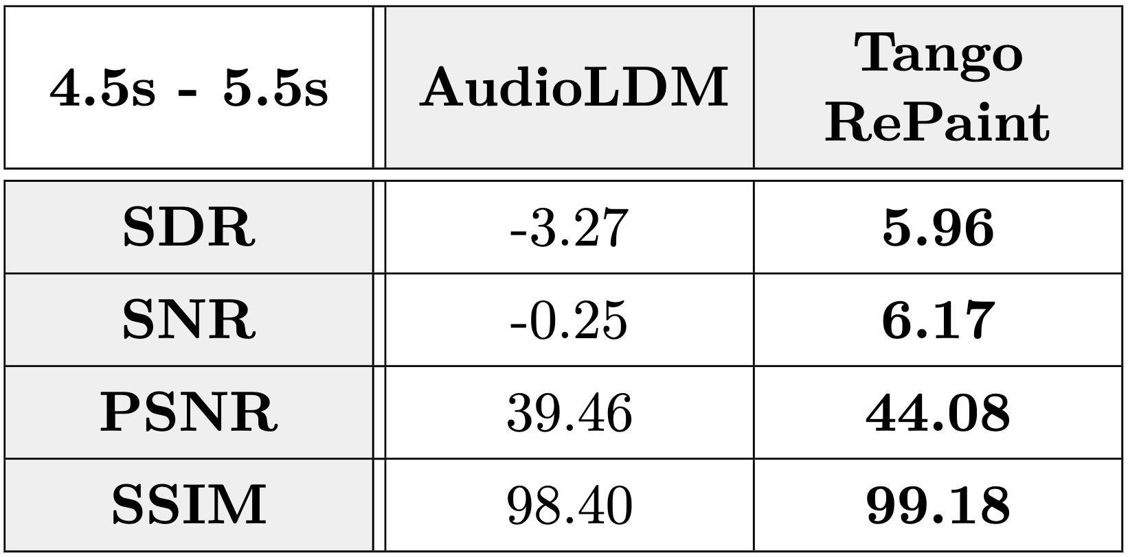
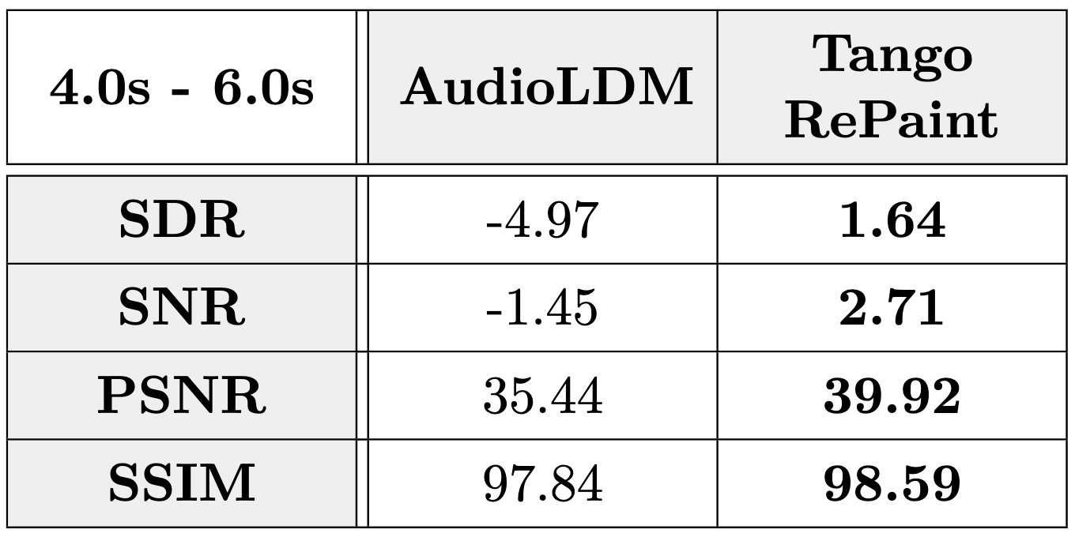
Average metrics (Tango + RePaint)
1 second gap
2 seconds gap
Metrics computed on audio:
SDR Signal Distortion Ratio
SNR Signal Noise Ratio
Metrics computed on spectrograms:
PSNR Peak Signal Noise Ratio
SSIM Structural Similarity Index Measure (%)
Notes:
We evaluated the results using four different metrics. The signal-to-distortion ratio and the signal-to-noise ratio were computed on the resulting waveform, while the peak signal-to-noise ratio and the Structural Similarity Index were computed on the spectrograms. In these tables you can see the averages over all the 24 clips. From these results we can clearly see that the baseline fall short in comparison to the approach combining Tango and RePaint.

Slide 11




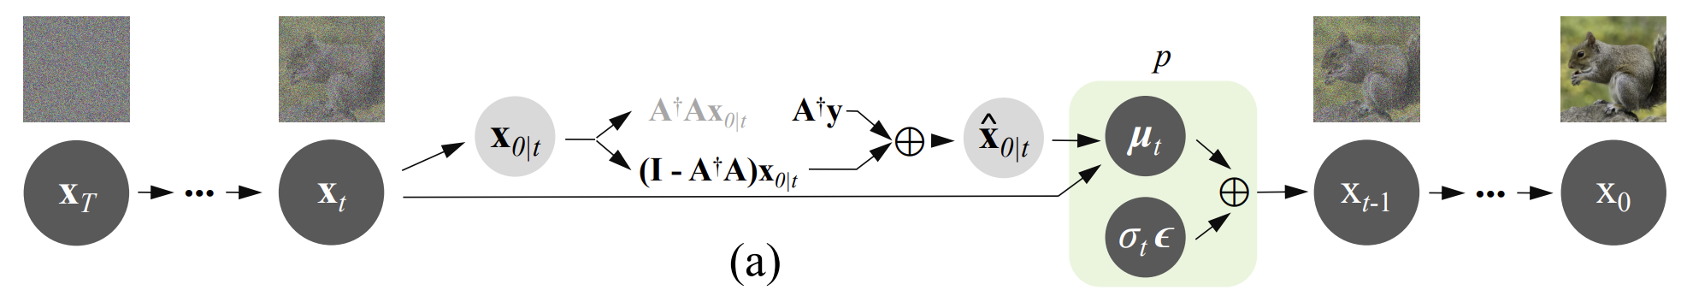
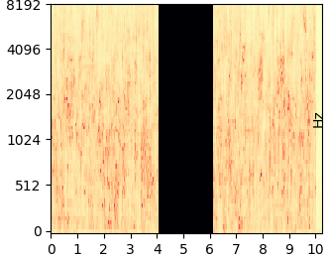
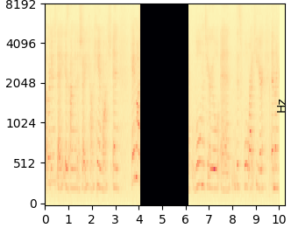
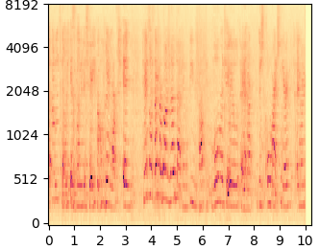
Denoising in communication scenarios: DDNM
Tests were performed adding white Gaussian noise to audio clips and then trying to remove it
Noisy channel
Sender
Receiver
DDNM is a framework for image restoration which refines the null-space content during the reverse diffusion process to perform tasks such as denoising and inpainting
DDNM for denoising
DDNM for inpainting
Notes:
This method has demonstrated its effectiveness in audio inpainting. However, we also considered an additional scenario in which audio is transmitted through a noisy communication channel where the signal is corrupted. Most approaches address this issue sending additional data to reconstruct the signal. However, in cases where only the semantic information is needed, it may be enough to predict the original audio. To perform denoising and inpainting we used the Denoising Diffusion Null-Space Model, a technique again borrowed from the image domain, which focuses on refining the null-space content during the reverse diffusion process. We applied it on the generative model Tango and tested it using four audio clips with added noise. We tried a peak signal-to-noise ratio of 20, which significally affects the quality of the audio, and a psnr of 30, which only have a slight impact on the signal. The denoising and inpainting capabilities were further combined to have a complete architecture.

Slide 12
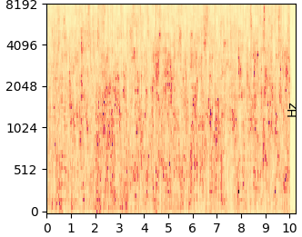
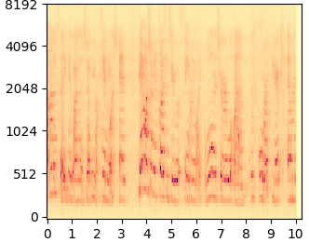
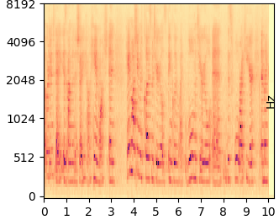
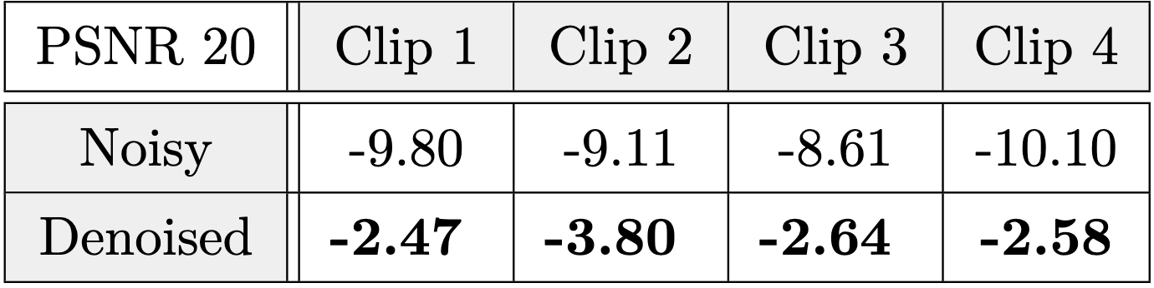
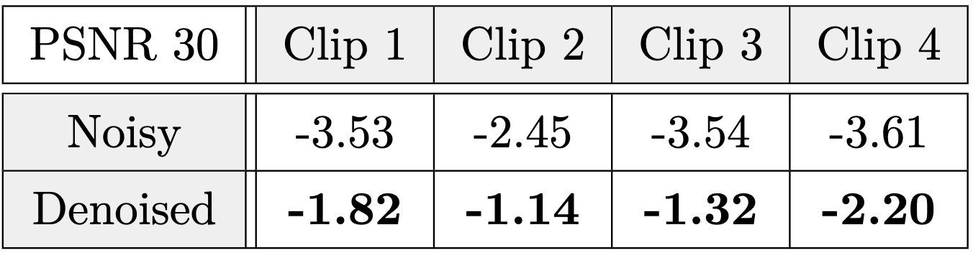
Results
“An adult female is speaking in a quiet environment”
Noisy
Denoised
Original
SNR
SNR
Notes:
Here you can have a glimpse of the denoising capabilities of the chosen technique. Starting from this noisy version [noisy], the model predicted this denoised version [denoised] which is almost identical to the original audio [original]. The validity of the results is also confirmed by the Signal-to-Noise ratios computed before and after the application of the denoising technique. You can see in the tables that in all cases the snr improves in the denoised version of the sample.

Slide 13

Conclusions
The proposed combination of Tango + RePaint consistently outperforms the baseline results for inpainting with clean audios as input
The use of DDNM enables remarkable denoising capabilities, even in scenarios with substantial levels of noise
and Future works
Create an automated communication system to perform denoising, identify problematic segments and inpaint them
Remove conditioning from text and perform inpainting based only on the known portion of audio
Paper in progress!
Notes:
Finally let’s draw the conclusions. The proposed combination of Tango and RePaint consistently achieves better results than AudioLDM for inpainting when clean audios are used as input. Instead, when having to deal with noisy audio, the use of DDNM allows to perform denoising achieving amazing results. To carry on our research, two ideas could be further explored. The former regarding the creation of a communication system to automatically identify the problematic segments after denoising and inpaint them. The latter regarding inpainting without a text description, using only the known portion of the audio as conditioning. This second point is currently being developed as part of an academic paper regarding this work. That’s all for my presentation. Thank you for the attention and have a good day!

Slide 14
References
Jonathan Ho, Ajay Jain, and Pieter Abbeel. Denoising Diffusion Probabilistic Models. 2020. arXiv: 2006.11239 [cs.LG].
Haohe Liu et al. AudioLDM: Text-to-Audio Generation with Latent Diffusion Models. 2023. arXiv: 2301.12503 [cs.SD].
Deepanway Ghosal et al. Text-to-Audio Generation using Instruction-Tuned LLM and Latent Diffusion Model. 2023. arXiv: 2304.13731 [eess.AS].
Yinhuai Wang, Jiwen Yu, and Jian Zhang. Zero-Shot Image Restoration Using Denoising Diffusion Null-Space Model. 2022. arXiv: 2212.00490 [cs.CV].
Andreas Lugmayr et al. RePaint: Inpainting using Denoising Diffusion Probabilistic Models. 2022. arXiv: 2201.09865 [cs.CV].
Chris Dongjoo Kim et al. “AudioCaps: Generating Captions for Audios in The Wild”. In: Proceedings of the 2019 Conference of the North American Chapter of he Association for Computational Linguistics: Human Language Technologies, Volume 1 (Long and Short Papers). Minneapolis, Minnesota: Association for Computational Linguistics, June 2019, pp. 119–132. doi: 10.18653/v1/N191011. url: https://aclanthology.org/N19-1011.

Slide 15
Backup slides

Slide 16
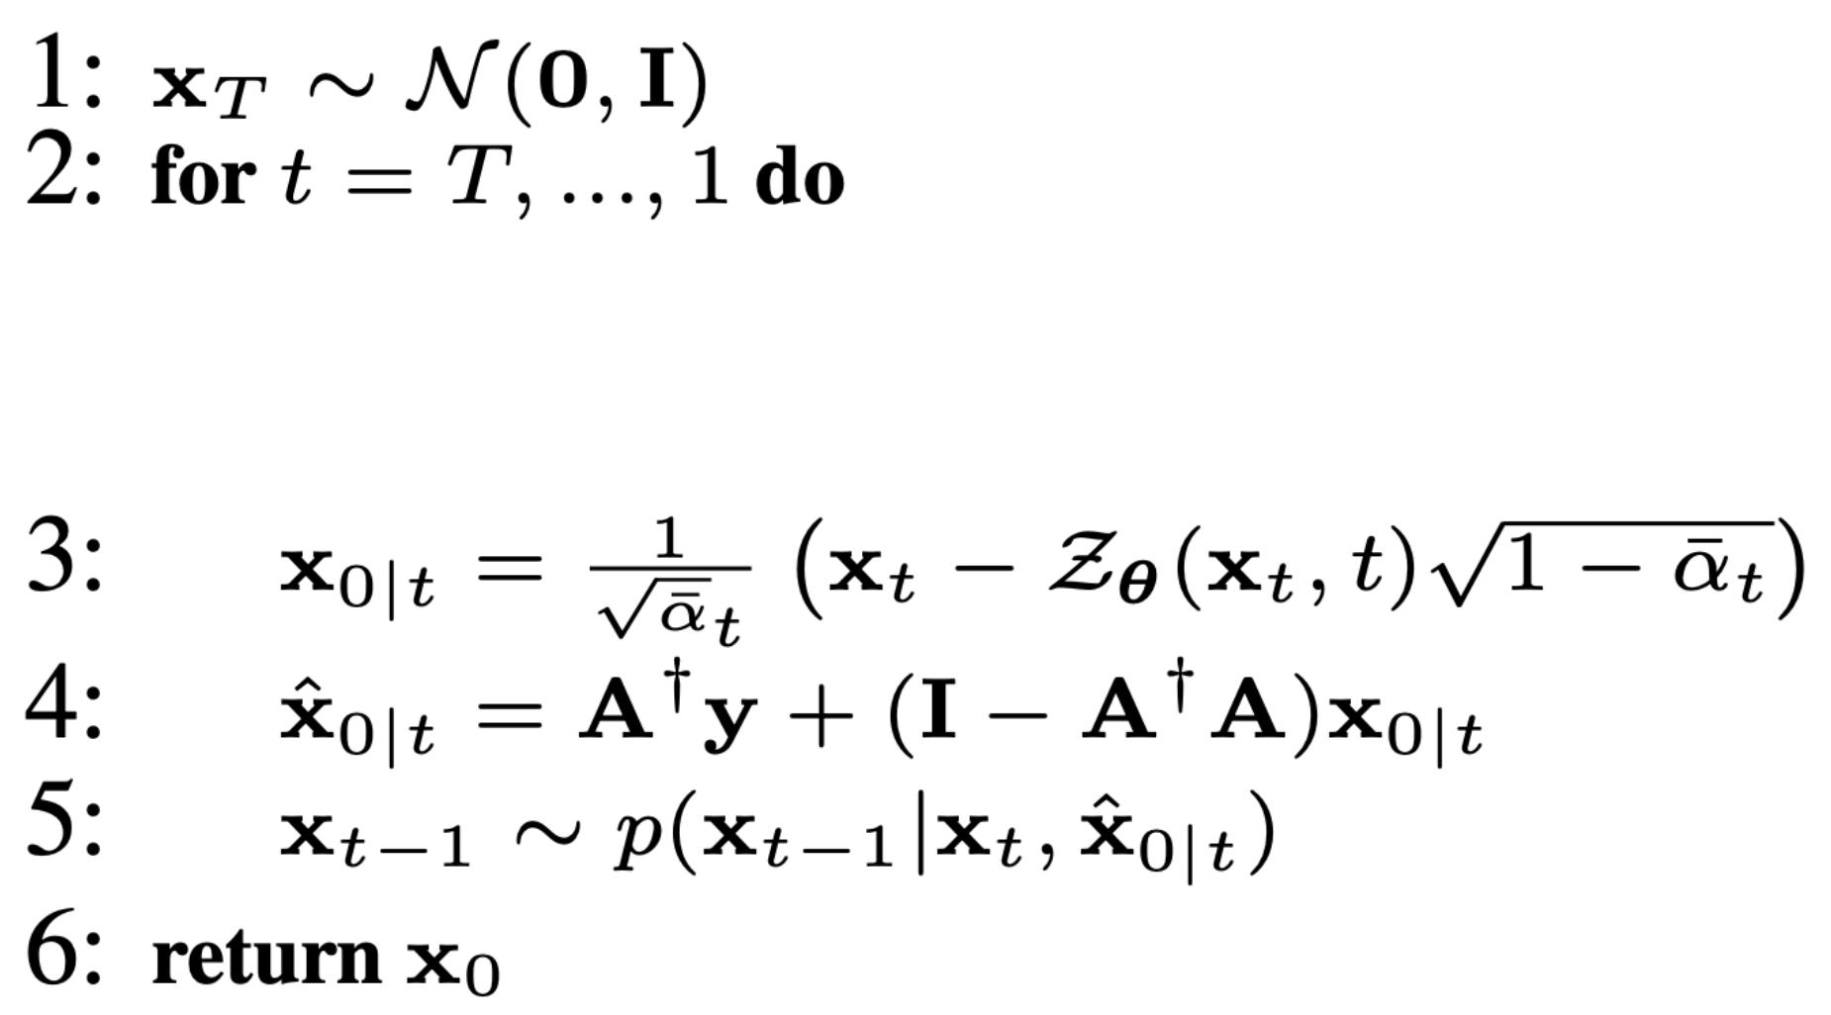
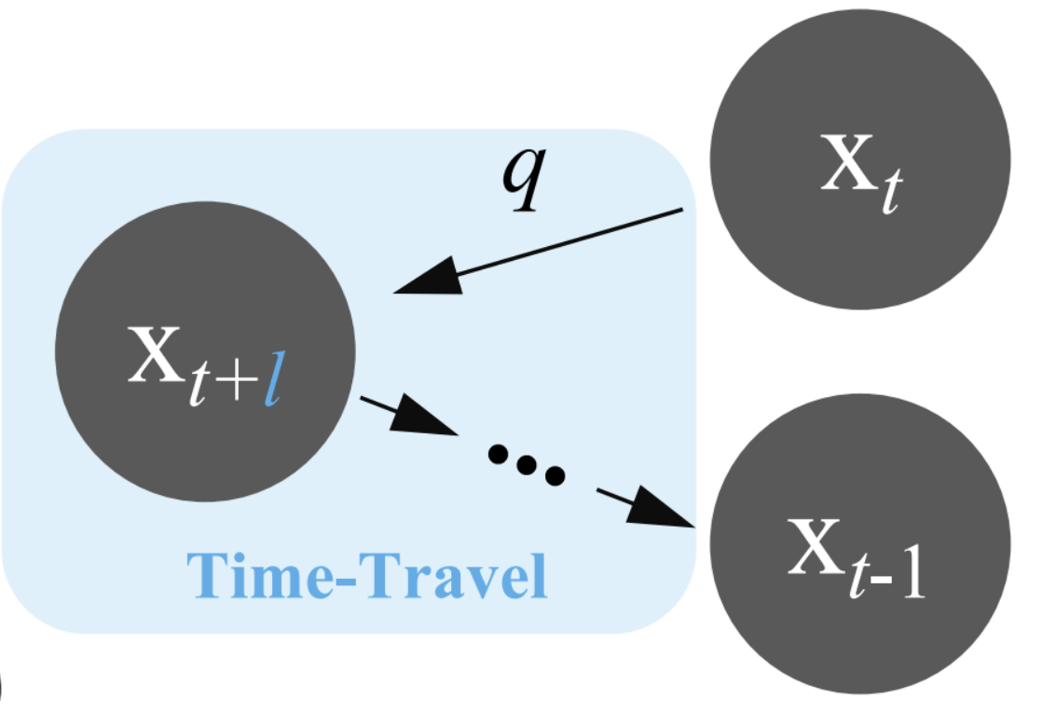
DDNM and DDNM⁺
DDNM (Denoising Diffusion Null-Space Model) is a framework for image restoration which refines the null-space content during the reverse diffusion process to produce results that satisfy data consistency and realism
Task: reconstruct x̂ from y where y = Ax
DDNM⁺: Through the time-travel trick we generate a better “past”, which in turn leads to a better “future”

Slide 17
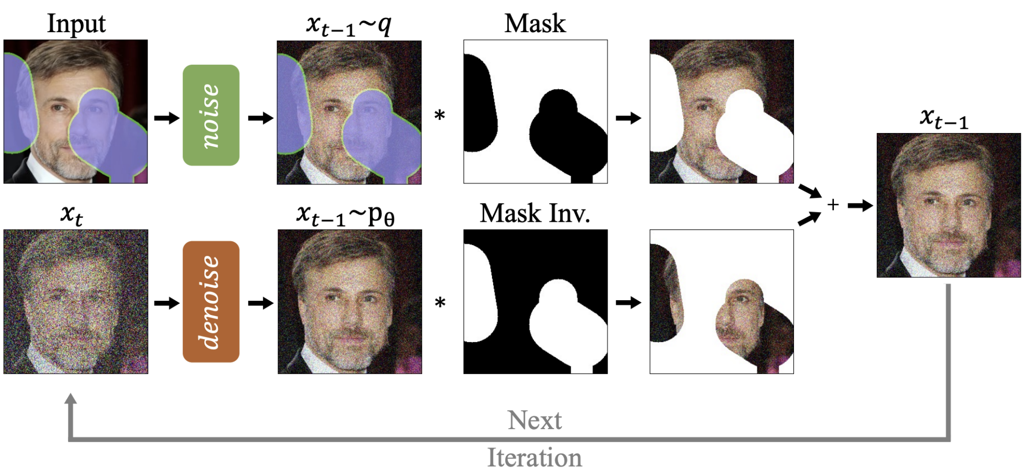
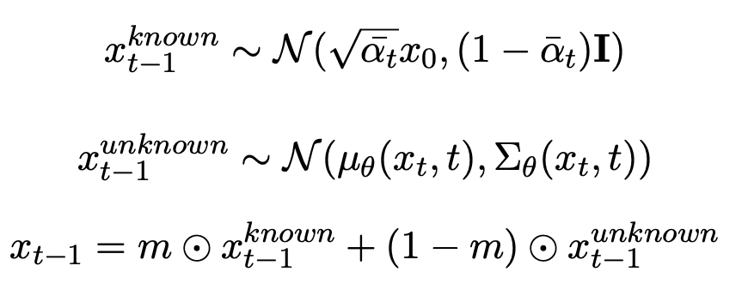
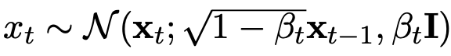
RePaint and RePaint⁺
RePaint: sample the unmasked regions using the available information as conditioning during the diffusion process
x_{t-1} is diffused back to x_{t}
the denoising step is performed again
The model has more time to effectively incorporate the provided information with the generated part
RePaint⁺: The latent representation is diffused back to multiple previous steps and then all of them are sequentially performed again

Slide 18
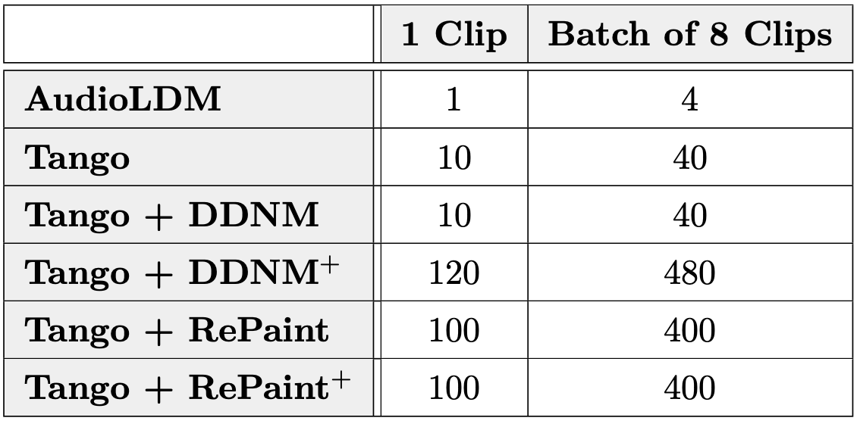
Inference times
Inference times in minutes using one GPU NVIDIA Tesla T4
Listen to the audio clips at: https://www.andrearodriguez.it/inpainting

Slide 19
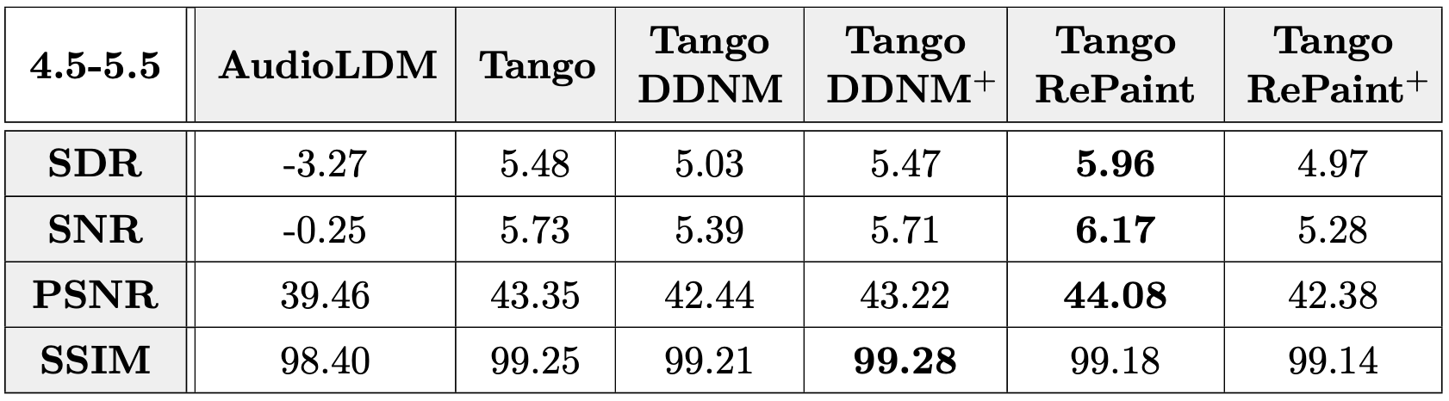
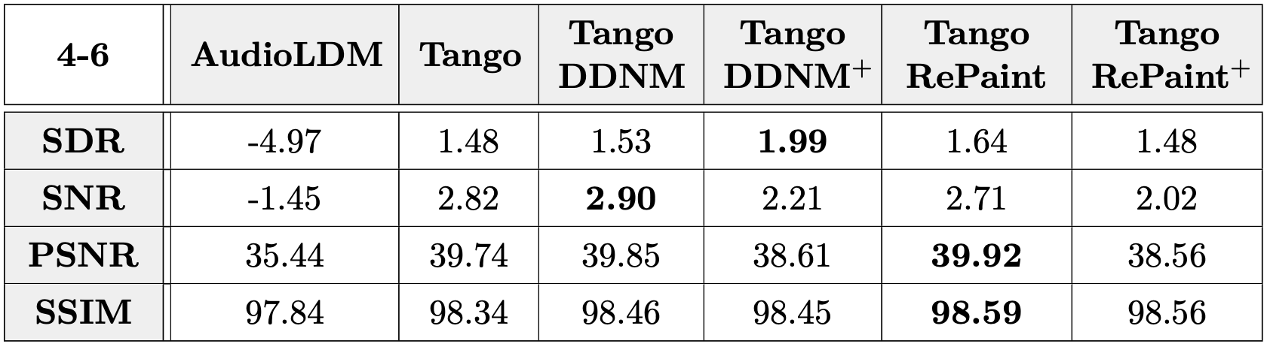
Metrics
SDR = Signal Distortion Ratio
SNR = Signal Noise Ratio
PSNR = Peak Signal Noise Ratio
SSIM = Structural Similarity Index Measure
1 second gap
2 seconds gap
* SSIM values are multiplied by 100

